Slide 1

Modeling 7조

Slide 2





Slide 3
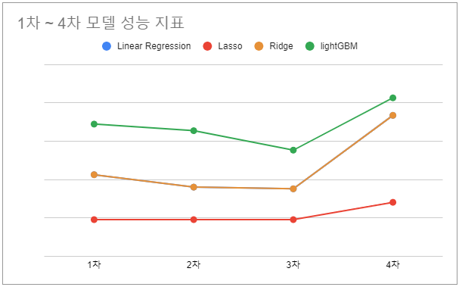
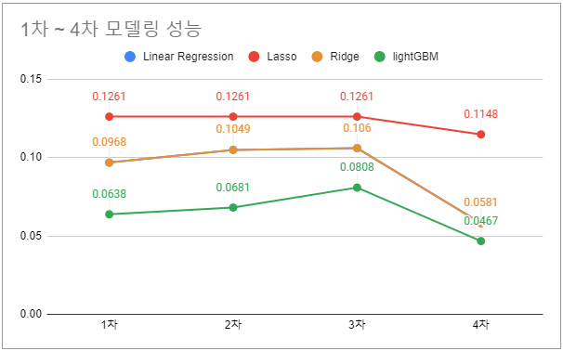

Slide 4

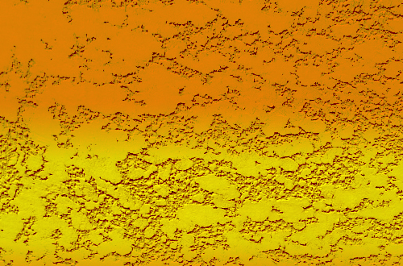

YELLOW TEAM’S
DESIGN GROUNDS
TM
Team 7
PUBG Modeling
TM

Slide 5
Team 7
PUBG Modeling
TM

Slide 6


Team 7
CHAPTER 0
Chapter. 0
7조 소개
TEAM 7 MEMBER
JIN
SEUNG
BUM
MODELING
CHOI
YOONA
MODELING
MOON
SEOK
MIN
TEAM
LEADER
OH
SE
YEON
MODELING
REPORT
YUN
SANG
HYUN
MODELING
PPT
TEAM MEMBER 5/5
RECEIVE INVITE

Slide 7
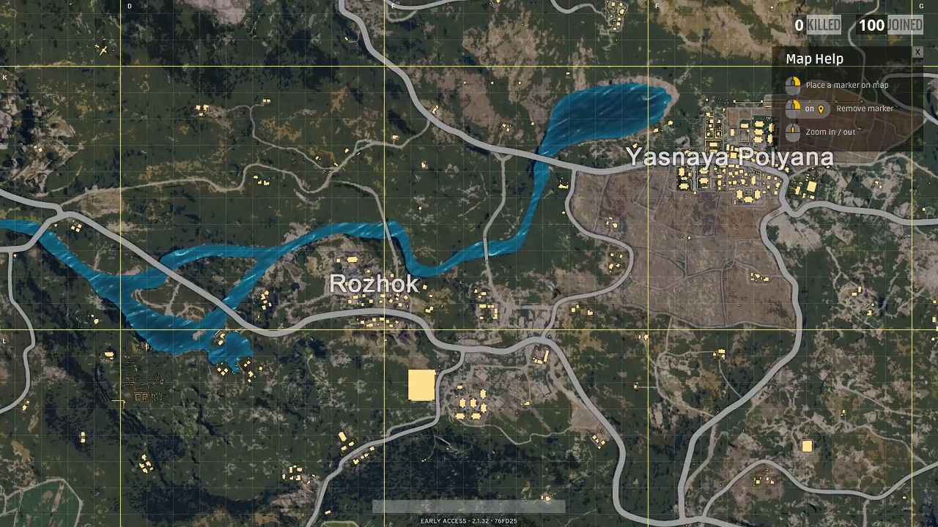
Team 7
CHAPTER 0
Chapter. 0
모델링 7조 workflow
Hyperparameter Tuning
4th modeling
3th modeling
2nd modeling
1st modeling
Group by
Categorical
Make new feature
Categorical
VIF
다중공선성 columns drop
Categorical
Object columns drop
LightGBM
TEAM MEMBER 5/5
RECEIVE INVITE

Slide 8

CONTENTS
CHAPTER.1
1st Modeling
CHAPTER.2
2nd Modeling
CHAPTER.3
3th Modeling
CHAPTER.4
Final Modeling
CHAPTER.5
YELLOW TEAM’S
DESIGN GROUNDS
Hyperparameter Tuning
CHAPTER.6
TM
insight

Slide 9
CHAPTER. 1
1st Modeling

Slide 10
Team 7
CHAPTER1
CHAPTER2
CHAPTER3
CHAPTER4
CHAPTER5
CHAPTER6
Chapter. 1
모델링 7조 workflow
Hyperparameter Tuning
4th modeling
3th modeling
2nd modeling
1st modeling
Group by
Categorical
Make new feature
Categorical
VIF
다중공선성 columns drop
Categorical
Object columns drop
LightGBM
TEAM MEMBER 5/5
RECEIVE INVITE

Slide 11

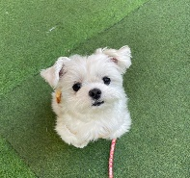



Team 7
CHAPTER1
CHAPTER1
CHAPTER6
CHAPTER2
CHAPTER3
CHAPTER4
CHAPTER5
CHAPTER6
Chapter. 1
CHAPTER2
CHAPTER3
CHAPTER4
CHAPTER5
Column 담당 지정
진승범
최윤아
문석민
오세연
윤상현
- kills
- killStreaks
- weaponsAcquired
- damageDealt
- longestKill
- headshotKills
- killStreaks
- kills
- DBNOs
- damageDealt
- killPoints
- winPoints
- numGroups
- maxPlace
winPlacePerc
- matchType
- damageDealt
- boosts
- heals
- assists
- revives
- matchType
- rideDistance
- swimDistance
- walkDistance
- weaponsAcquired
- vehicleDestroys
- Id
- matchId
- groupId
TEAM MEMBER 5/5
RECEIVE INVITE

Slide 12
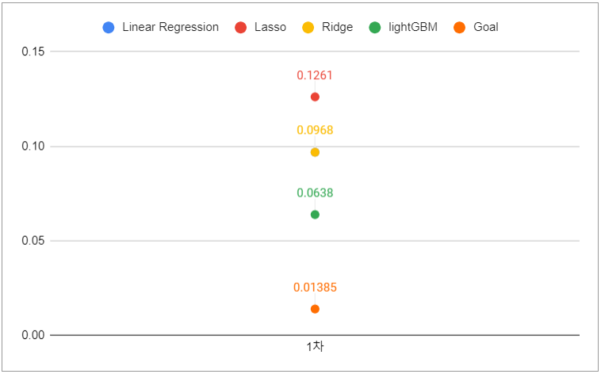
Team 7
CHAPTER1
CHAPTER2
CHAPTER3
CHAPTER4
CHAPTER5
CHAPTER6
Chapter. 1
모델링 1차 결과
1st MODELING
TEAM MEMBER 5/5
RECEIVE INVITE

Slide 13
CHAPTER. 2
2nd Modeling

Slide 14
Team 7
CHAPTER1
CHAPTER2
CHAPTER3
CHAPTER4
CHAPTER5
CHAPTER6
Chapter. 2
모델링 7조 workflow
Hyperparameter Tuning
4th modeling
3th modeling
2nd modeling
1st modeling
Group by
Categorical
Make new feature
Categorical
VIF
다중공선성 columns drop
Categorical
Object columns drop
LightGBM
TEAM MEMBER 5/5
RECEIVE INVITE

Slide 15
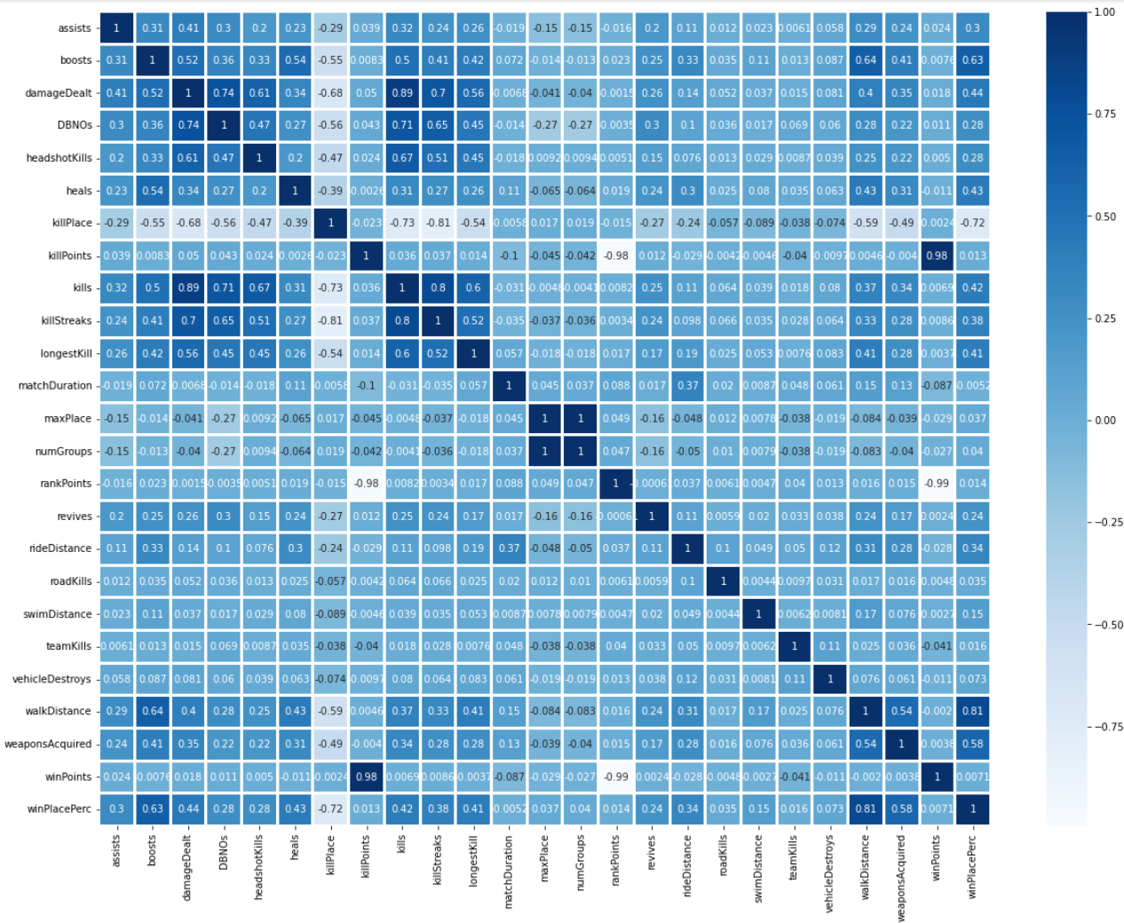
Team 7
CHAPTER1
CHAPTER2
CHAPTER3
CHAPTER4
CHAPTER5
CHAPTER6
Chapter. 2
모델링 2차 – Corr
EDA
TEAM MEMBER 5/5
RECEIVE INVITE

Slide 16
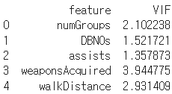
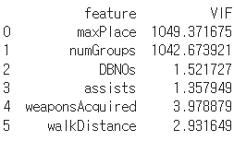
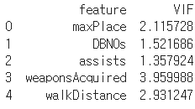
Team 7
CHAPTER1
CHAPTER2
CHAPTER3
CHAPTER4
CHAPTER5
CHAPTER6
Chapter. 2
모델링 2차 – VIF
VIF
TEAM MEMBER 5/5
RECEIVE INVITE

Slide 17
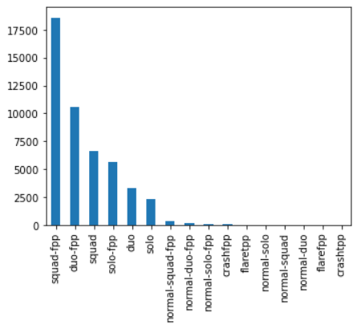
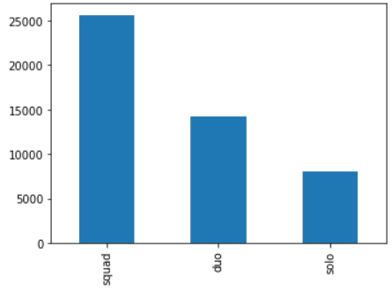
Team 7
CHAPTER1
CHAPTER2
CHAPTER3
CHAPTER4
CHAPTER5
CHAPTER6
Chapter. 2
모델링 2차 – VIF
matchType
TEAM MEMBER 5/5
RECEIVE INVITE

Slide 18
Team 7
CHAPTER1
CHAPTER2
CHAPTER3
CHAPTER4
CHAPTER5
CHAPTER6
Chapter. 2
Columns 변화
Columns
- matchType
- damageDealt
- boosts
- heals
- assists
- Revives
- rideDistance
- swimDistance
- walkDistance
- weaponsAcquired
- vehicleDestroys
- kills
- killStreaks
- longestKill
- headshotKills
- DBNOs
- numGroups
- killPlace
- killPoints
- winPoints
- maxPlace
TEAM MEMBER 5/5
RECEIVE INVITE

Slide 19
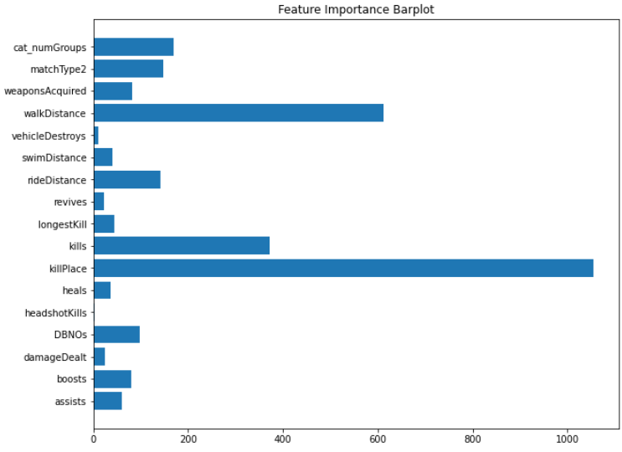
Team 7
CHAPTER1
CHAPTER2
CHAPTER3
CHAPTER4
CHAPTER5
CHAPTER6
Chapter. 2
Columns 변화
Feature
Importance
TEAM MEMBER 5/5
RECEIVE INVITE

Slide 20
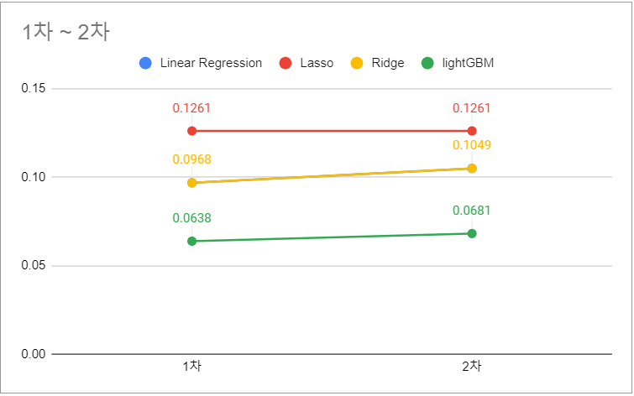
Team 7
CHAPTER1
CHAPTER2
CHAPTER3
CHAPTER4
CHAPTER5
CHAPTER6
Chapter. 2
모델링 2차 결과
2nd MODELING
TEAM MEMBER 5/5
RECEIVE INVITE

Slide 21
CHAPTER. 3
3th Modeling

Slide 22
Team 7
CHAPTER1
CHAPTER2
CHAPTER3
CHAPTER4
CHAPTER5
CHAPTER6
Chapter. 3
모델링 7조 workflow
Hyperparameter Tuning
4th modeling
3th modeling
2nd modeling
1st modeling
Group by
Categorical
Make new feature
Categorical
VIF
다중공선성 columns drop
Categorical
Object columns drop
LightGBM
TEAM MEMBER 5/5
RECEIVE INVITE

Slide 23
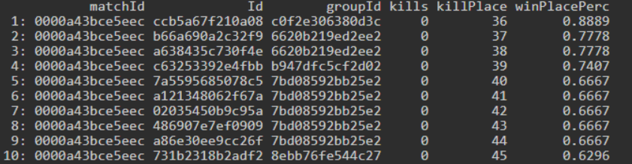
Team 7
CHAPTER1
CHAPTER2
CHAPTER3
CHAPTER4
CHAPTER5
CHAPTER6
Chapter. 3
Data leakage
Data leakage
- killPlace
Sort : matchId – groupId – KillPlace
TEAM MEMBER 5/5
RECEIVE INVITE

Slide 24
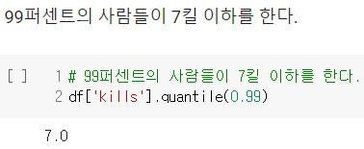
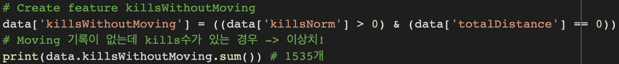
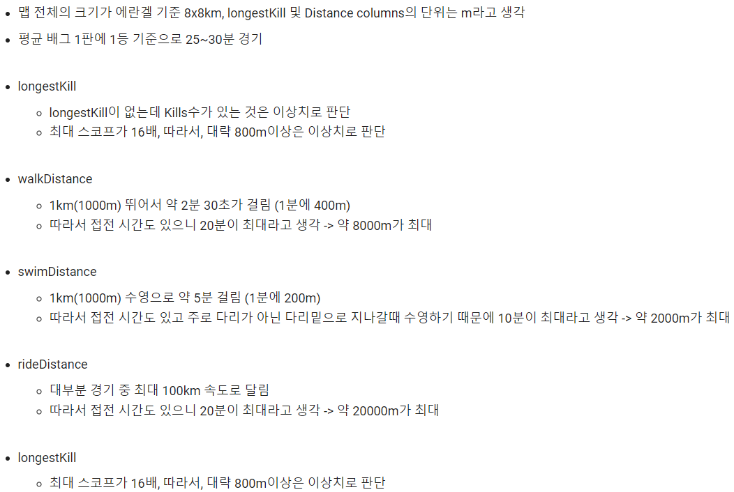
Team 7
CHAPTER1
CHAPTER2
CHAPTER3
CHAPTER4
CHAPTER5
CHAPTER6
Chapter. 3
Data leakage
Outlier drop
TEAM MEMBER 5/5
RECEIVE INVITE

Slide 25
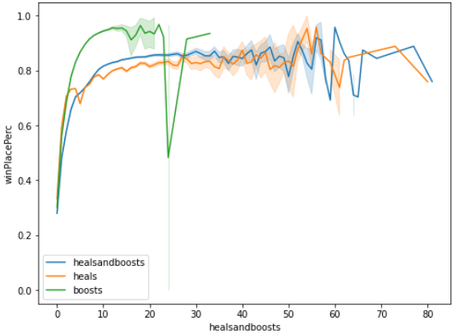
Team 7
CHAPTER1
CHAPTER2
CHAPTER3
CHAPTER4
CHAPTER5
CHAPTER6
Chapter. 3
모델링 3차 – Heal and Boost
Heal and boost
TEAM MEMBER 5/5
RECEIVE INVITE

Slide 26
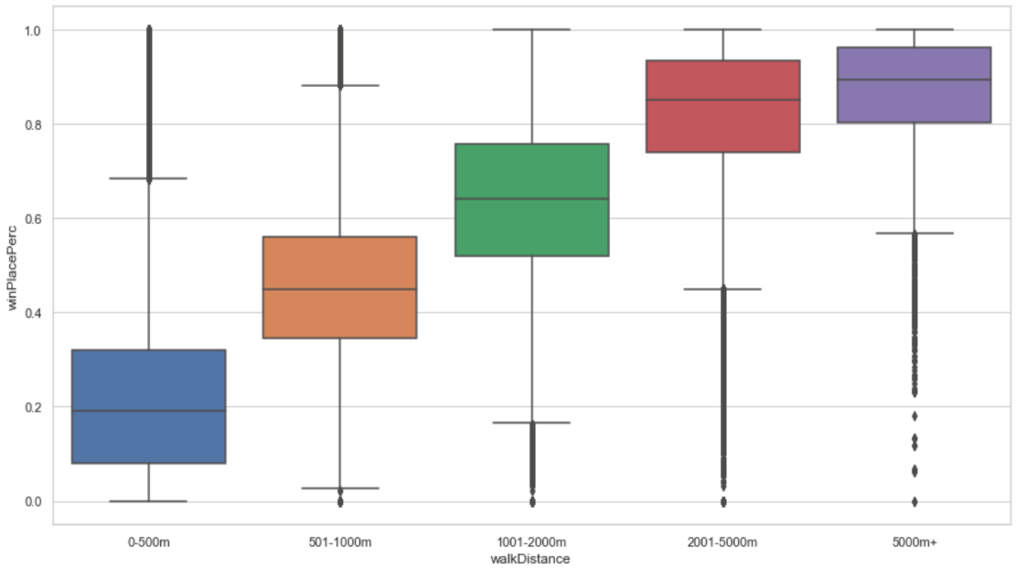
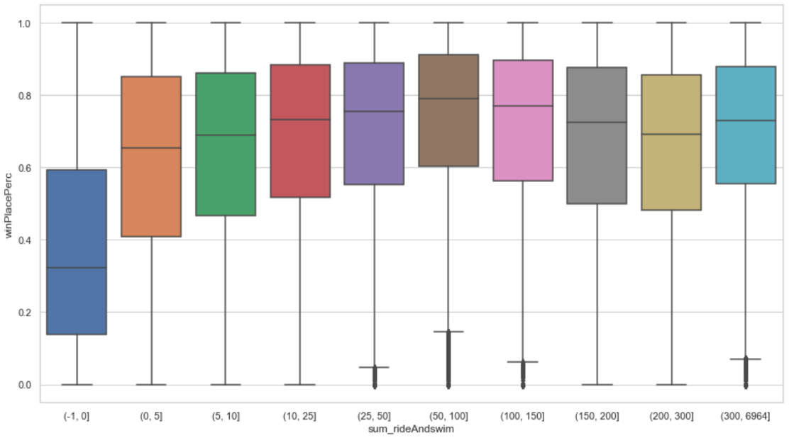
Team 7
CHAPTER1
CHAPTER2
CHAPTER3
CHAPTER4
CHAPTER5
CHAPTER6
Chapter. 3
모델링 3차 – walkDistance, ride and swim Distnace
Categorical
walkDistance
rideAndswim
TEAM MEMBER 5/5
RECEIVE INVITE

Slide 27
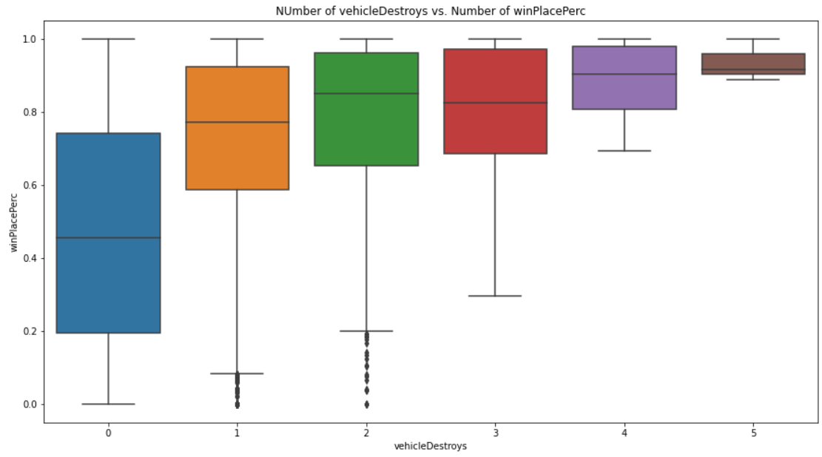
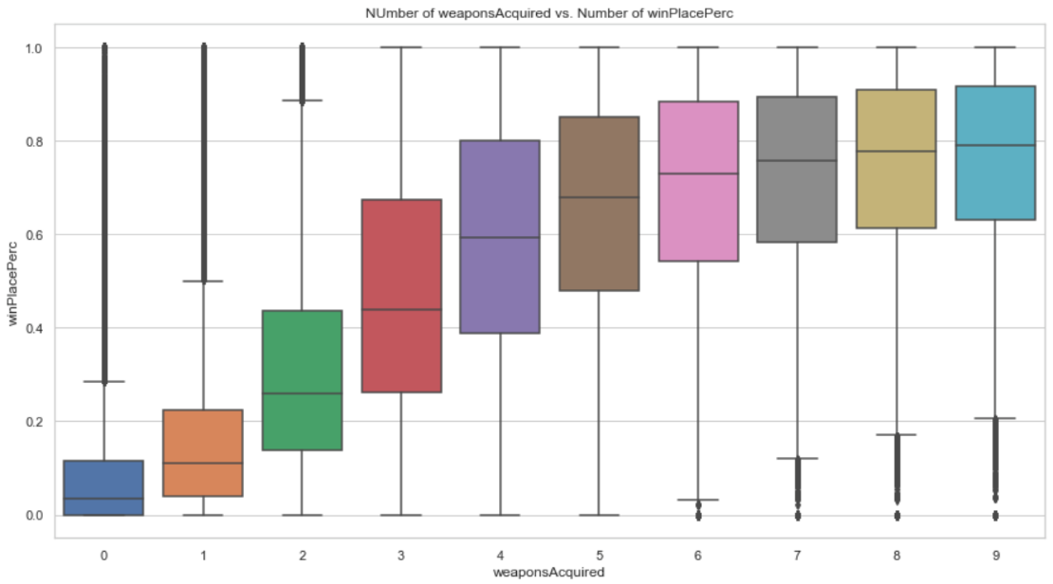
Team 7
CHAPTER1
CHAPTER2
CHAPTER3
CHAPTER4
CHAPTER5
CHAPTER6
Chapter. 3
모델링 3차 – vehicleDestroys, weaponsAcquired
Categorical
vehicleDestroys
weaponsAcquired
TEAM MEMBER 5/5
RECEIVE INVITE

Slide 28
Team 7
CHAPTER1
CHAPTER2
CHAPTER3
CHAPTER4
CHAPTER5
CHAPTER6
Chapter. 3
Columns 변화
Columns
- matchType
- assists
- Revives
- killStreaks
- longestKill
- headshotKills
- DBNOs
- numGroups
- weaponsAcquired
- vehicleDestroys
- walkDistance
- rideDistance
- swimDistance
- damageDealt
- kills
- killPlace
- boosts
- heals
- walkDistance
- rideDistance
- swimDistance
damageDealt
kills
- rideDistance
- swimDistance
- boosts
- heals
normalization
- totalDistance
- binary_rideAndswim
- heals_boosts
- damageDealtNorm
- killsNorm
TEAM MEMBER 5/5
RECEIVE INVITE

Slide 29
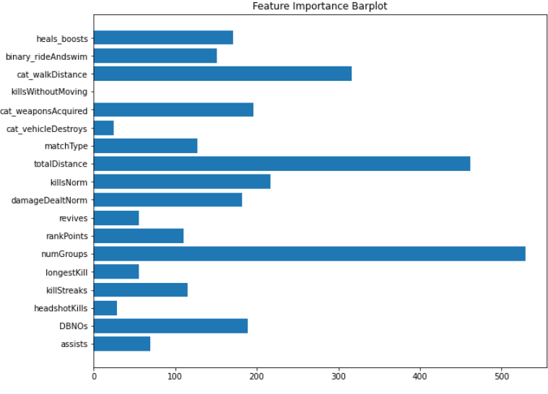
Team 7
CHAPTER1
CHAPTER2
CHAPTER3
CHAPTER4
CHAPTER5
CHAPTER6
Chapter. 3
모델링 3차 결과
Feature
Importance
TEAM MEMBER 5/5
RECEIVE INVITE

Slide 30
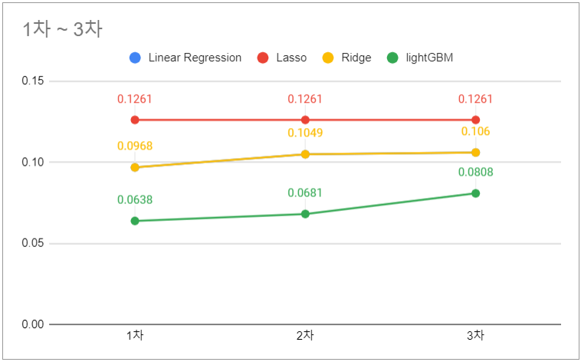
Team 7
CHAPTER1
CHAPTER2
CHAPTER3
CHAPTER4
CHAPTER5
CHAPTER6
Chapter. 3
모델링 3차 결과
3th MODELING
TEAM MEMBER 5/5
RECEIVE INVITE

Slide 31
CHAPTER. 4
Final Modeling

Slide 32
Team 7
CHAPTER1
CHAPTER2
CHAPTER3
CHAPTER4
CHAPTER5
CHAPTER6
Chapter. 4
모델링 7조 workflow
Hyperparameter Tuning
4th modeling
3th modeling
2nd modeling
1st modeling
Group by
Categorical
Make new feature
Categorical
VIF
다중공선성 columns drop
Categorical
Object columns drop
LightGBM
TEAM MEMBER 5/5
RECEIVE INVITE

Slide 33


Team 7
CHAPTER1
CHAPTER2
CHAPTER3
CHAPTER4
CHAPTER5
CHAPTER6
Chapter. 4
Final Modeling – matchId and groupId
Features
- matchId
- groupId
Groupby – matchId and groupId
assists
boosts
DBNOs
headshotKills
heals
killPonints
totalDistance
MatchId
groupId
assists
boosts
DBNOs
headshotKills
heals
aeb375
4d4b58
3
5
2
3
7
MEAN
aeb375
4d4b58
3
5
2
3
7
aeb375
a930a9
5
7
1
5
2
TEAM MEMBER 5/5
RECEIVE INVITE

Slide 34
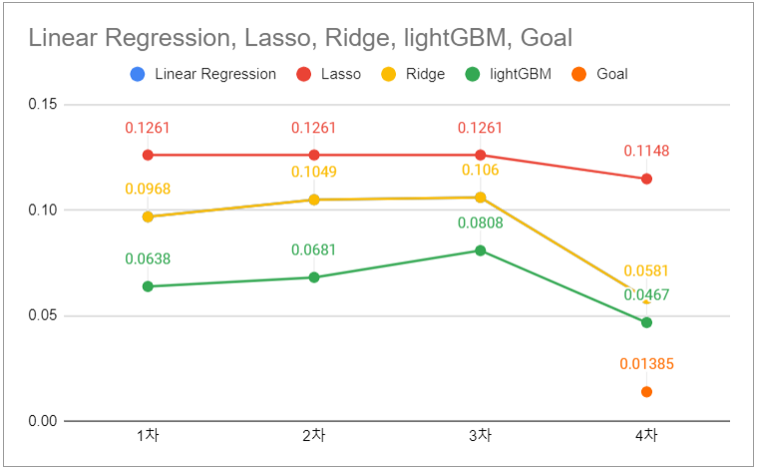
Team 7
CHAPTER1
CHAPTER2
CHAPTER3
CHAPTER4
CHAPTER5
CHAPTER6
Chapter. 4
Final Modeling 결과
Final
MODELING
TEAM MEMBER 5/5
RECEIVE INVITE

Slide 35
CHAPTER. 5
Hyperparameter
Tuning

Slide 36
Team 7
CHAPTER1
CHAPTER2
CHAPTER3
CHAPTER4
CHAPTER5
CHAPTER6
Chapter. 5
모델링 7조 workflow
Hyperparameter Tuning
4th modeling
3th modeling
2nd modeling
1st modeling
Group by
Categorical
Make new feature
Categorical
VIF
다중공선성 columns drop
Categorical
Object columns drop
LightGBM
TEAM MEMBER 5/5
RECEIVE INVITE

Slide 37
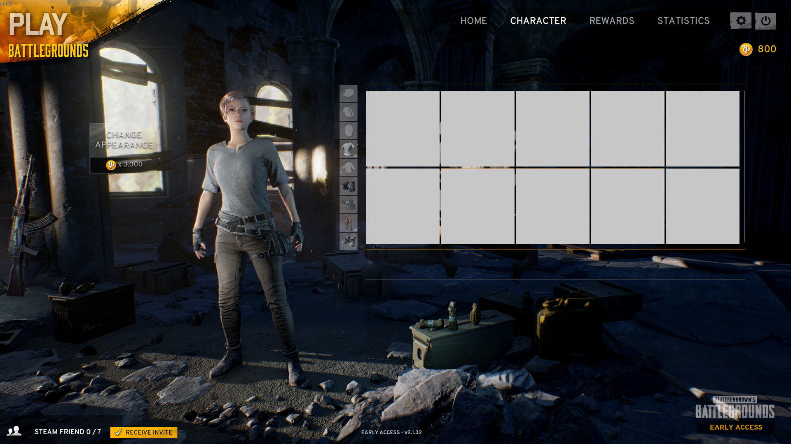
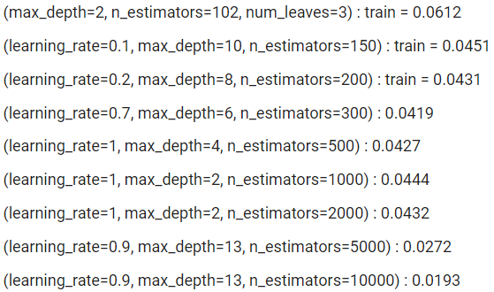
Team 7
CHAPTER1
CHAPTER2
CHAPTER3
CHAPTER4
CHAPTER5
CHAPTER6
Chapter. 5
Hyperparameter Tuning – LightGBM
Parameter
max_depth
num_leaves
min_data_in_leaf
n_estimators
learning_rate
LGBM
num_iterations
feature_fraction
metric
boosting
objective
RESULTS
TEAM MEMBER 5/5
RECEIVE INVITE

Slide 38
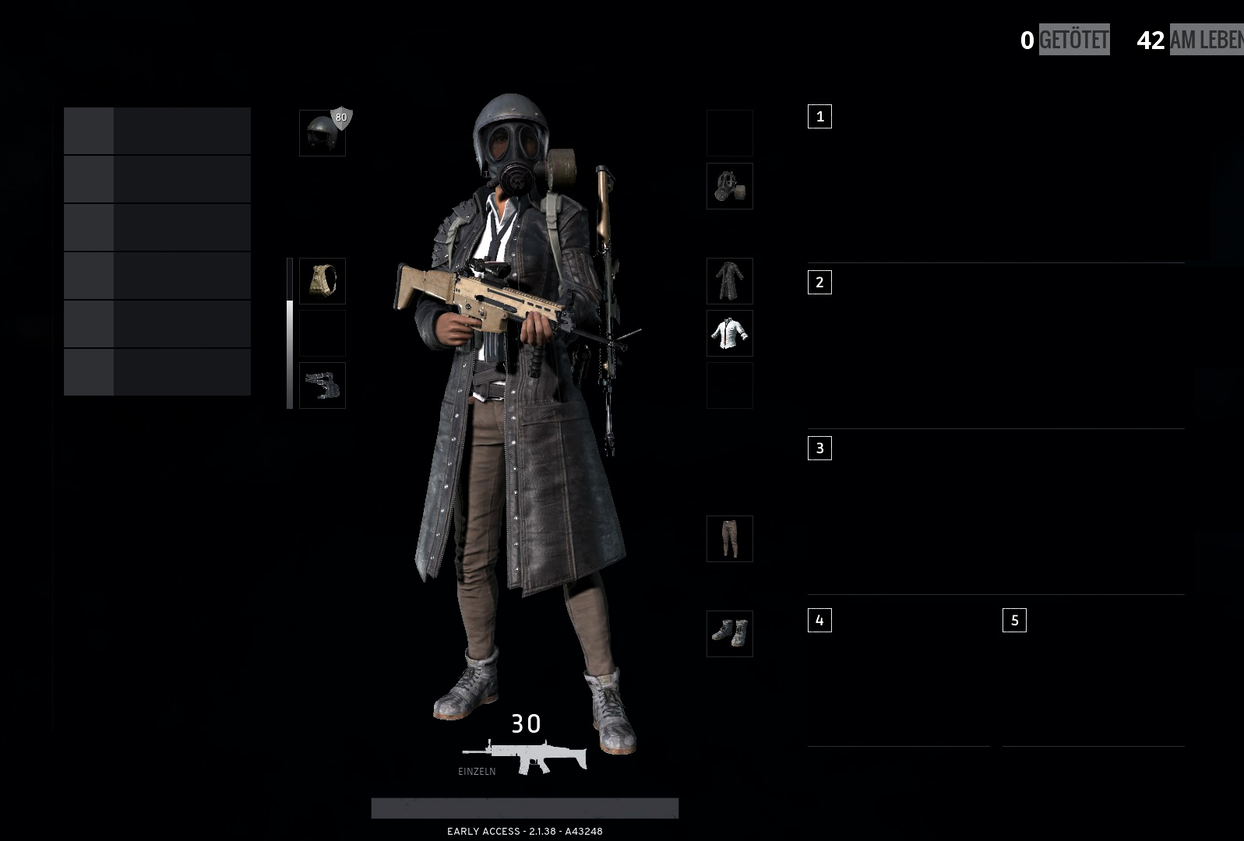

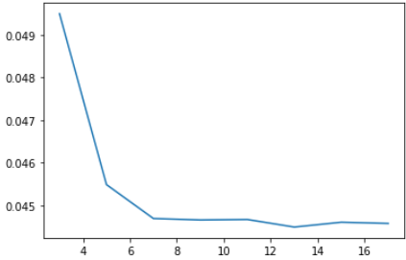


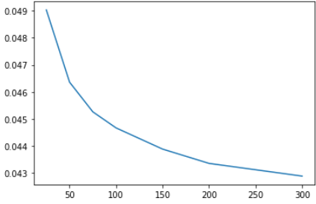
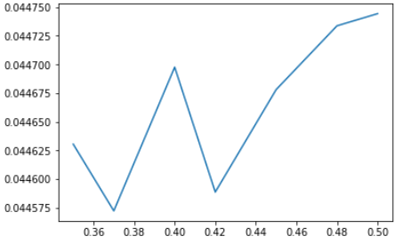
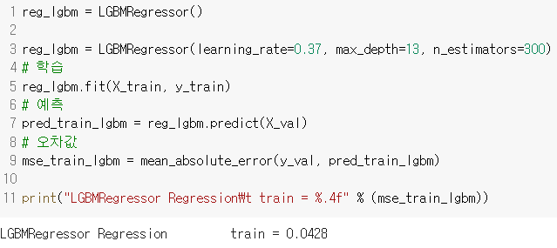
Team 7
CHAPTER1
CHAPTER2
CHAPTER3
CHAPTER4
CHAPTER5
CHAPTER6
Chapter. 5
Hyperparameter Tuning – LightGBM
max_depth
max_depth
n_estimators
13
learning_rate
n_estimators
300
learning_rate
0.37
TEAM MEMBER 5/5
RECEIVE INVITE

Slide 39
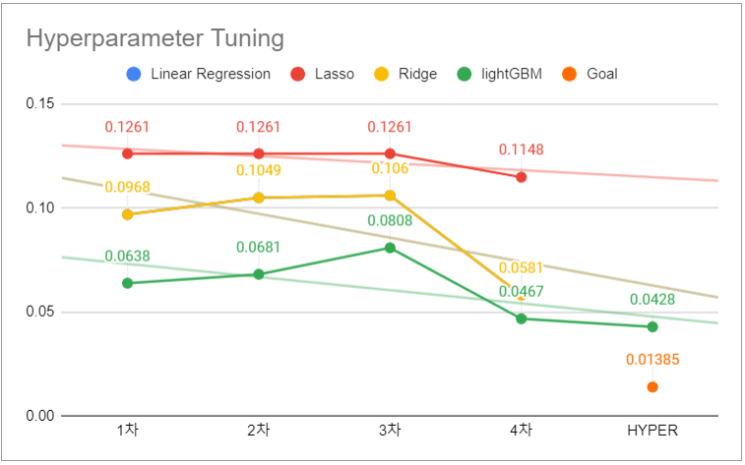
Team 7
CHAPTER1
CHAPTER2
CHAPTER3
CHAPTER4
CHAPTER5
CHAPTER6
Chapter. 5
Final Modeling 결과
Hyperparameter
Tuning
TEAM MEMBER 5/5
RECEIVE INVITE

Slide 40
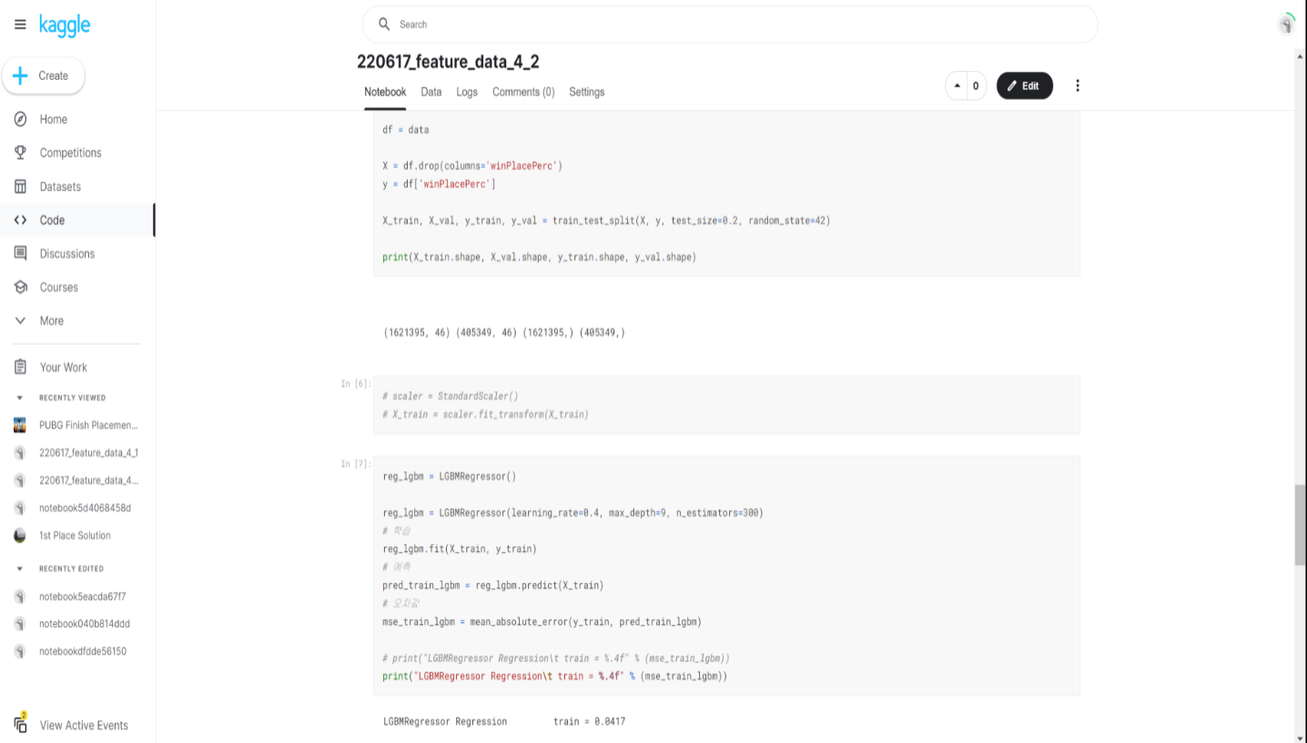
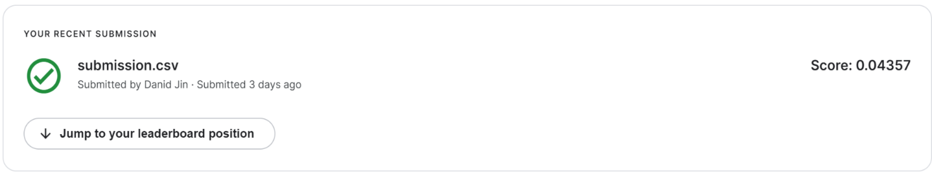
Team 7
CHAPTER1
CHAPTER2
CHAPTER3
CHAPTER4
CHAPTER5
CHAPTER6
Chapter. 5
Final Modeling 결과
Kaggle
TEAM MEMBER 5/5
RECEIVE INVITE

Slide 41
CHAPTER. 6
Insight

Slide 42


Team 7
CHAPTER1
CHAPTER2
CHAPTER3
CHAPTER4
CHAPTER5
CHAPTER6
Chapter. 6
Final Modeling 결과
Insight
TEAM MEMBER 5/5
RECEIVE INVITE

Slide 43
Team 7
CHAPTER1
CHAPTER2
CHAPTER3
CHAPTER4
CHAPTER5
CHAPTER6
Chapter. 6
Final Modeling 결과
Insight
TEAM MEMBER 5/5
RECEIVE INVITE

Slide 44

Team 7
CHAPTER1
CHAPTER2
CHAPTER3
CHAPTER4
CHAPTER5
CHAPTER6
Chapter. 6
질의응답
QUESTION ?
TEAM MEMBER 5/5
RECEIVE INVITE

Slide 45
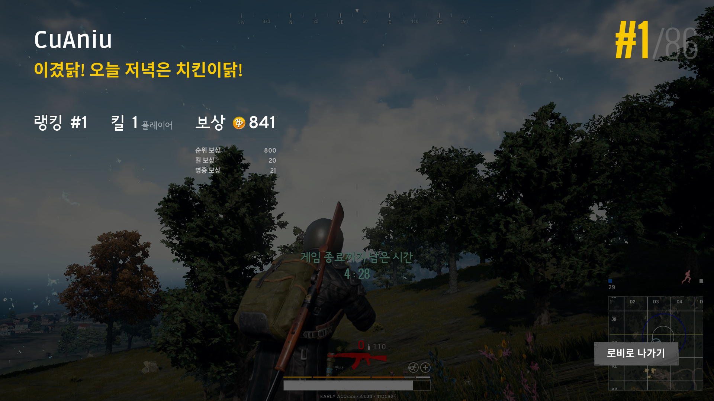
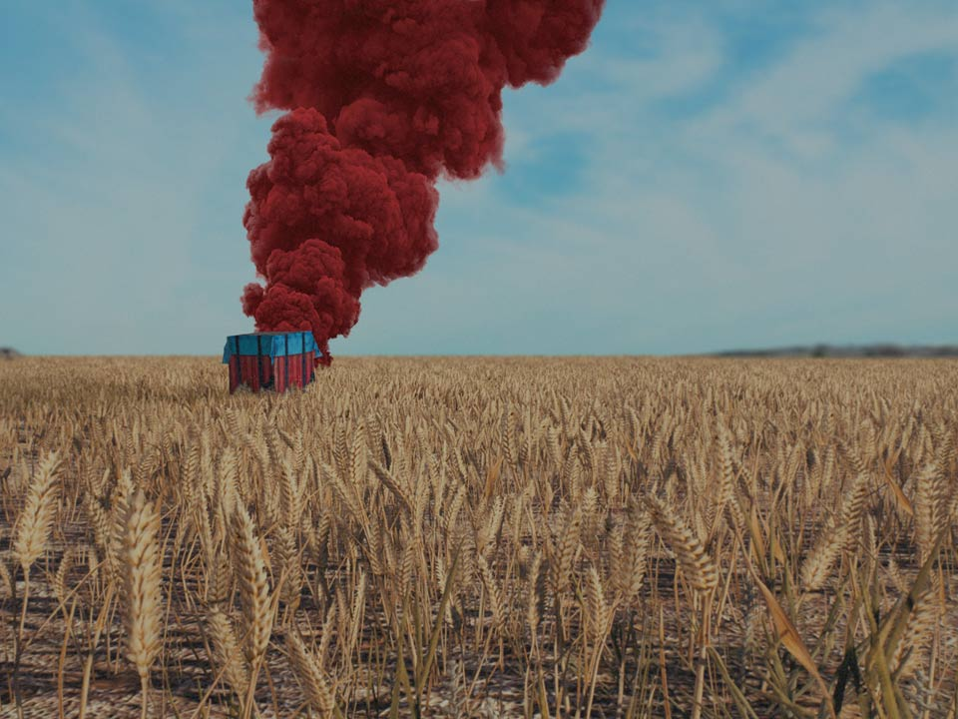
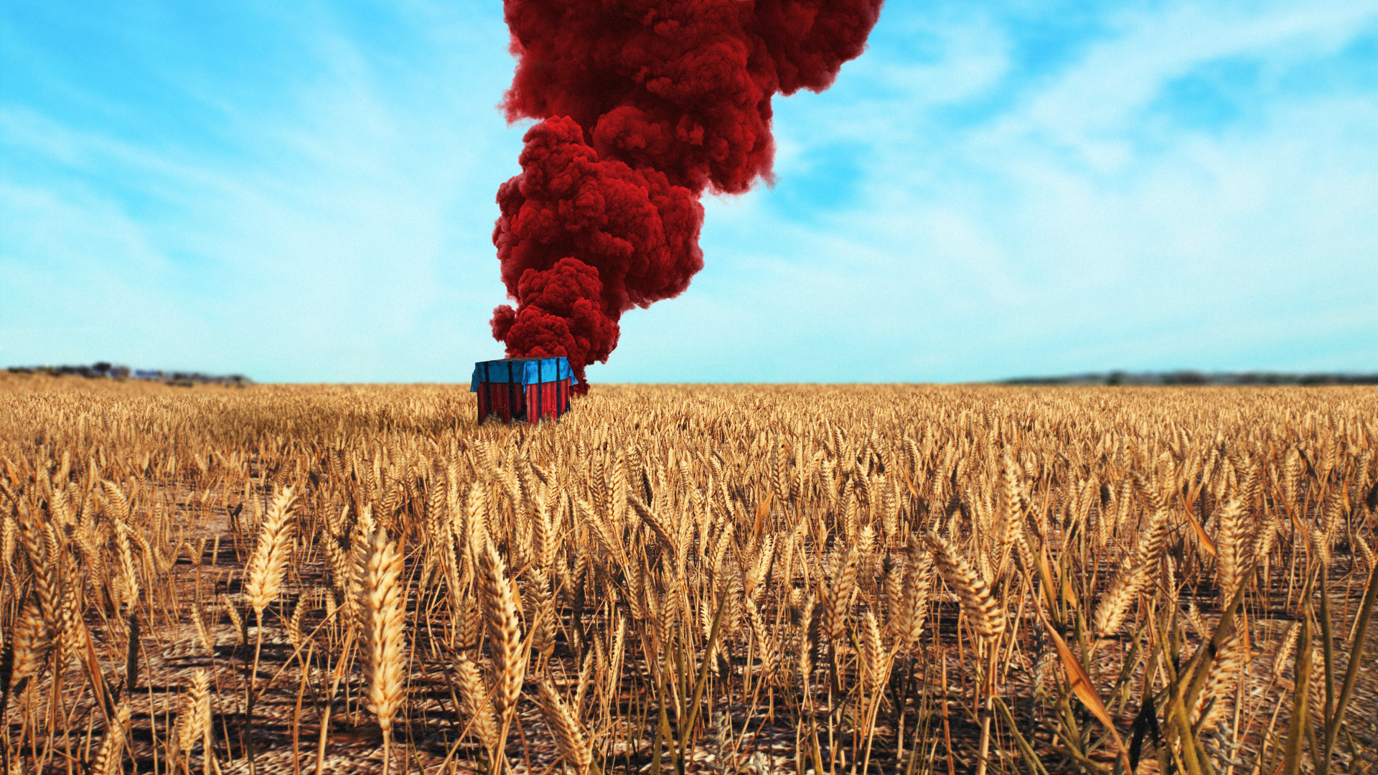
Modeling TEAM 7
#1/99
발표 끝났닭! 오늘 저녁은 치킨이닭!
감사합니다

